Slide 1
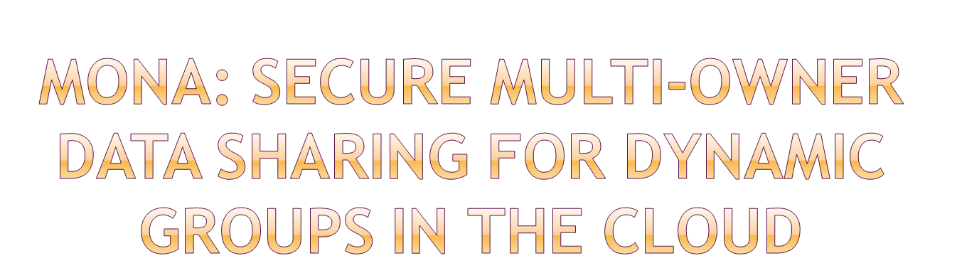

Slide 2
A large number of organizations today generate and share textual descriptions of their products, services, and actions .
Unfortunately, sharing data in a multi-owner manner while preserving data and identity privacy from an untrusted cloud is still a challenging issue, due to the frequent change of the membership. In this paper, we propose a secure multiowner data sharing scheme, named Mona, for dynamic groups in the cloud.
By leveraging group signature and dynamic broadcast encryption techniques, any cloud user can anonymously share data with others.

Slide 3
Meanwhile, the storage overhead and encryption computation cost of our scheme are independent with the number of revoked users.
In addition, we analyze the security of our scheme with rigorous proofs, and demonstrate the efficiency of our scheme in experiments.

Slide 4

To preserve data privacy, a basic solution is to encrypt data files, and then upload the encrypted data into the cloud. Unfortunately, designing an efficient and secure data sharing scheme for groups in the cloud is not an easy task.
However, the complexities of user participation and revocation in these schemes are linearly increasing with the number of data owners and the number of revoked users, respectively.

Slide 5

Privacy
Only the group manager can store and modify data in the cloud
The changes of membership make secure data sharing extremely difficult the issue of user revocation is not addressed
High expensive

Slide 6
Advantages:
Responsiveness and robustness.
Modularity and extensibility
Efficiency.
Transparency.

Slide 7

The changes of membership make secure data sharing extremely difficult the issue of user revocation is not addressed
Our proposed scheme is able to support dynamic groups efficiently. Specifically, new granted users can directly decrypt data files uploaded before their participation without contacting with data owners. User revocation can be easily achieved through a novel revocation list without updating the secret keys of the remaining users. The size and computation overhead of encryption are constant and independent with the number of revoked users.
We provide rigorous security analysis, and perform extensive simulations to demonstrate the efficiency of our scheme in terms of storage and computation overhead.

Slide 8


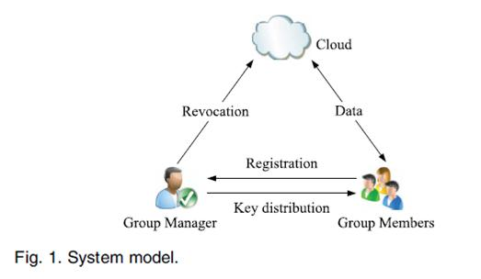

Slide 9

Signature Generation
Signature Verification
Revocation Verification

Slide 10

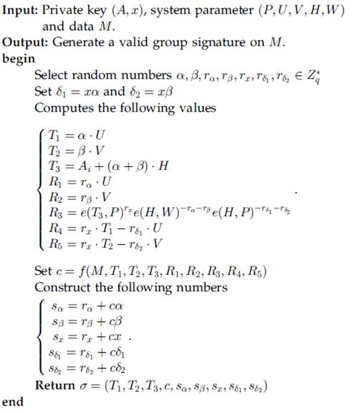
Signature Generation

Slide 11
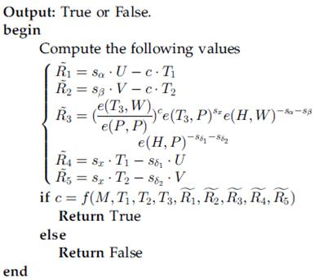
Signature Verification:

Slide 12

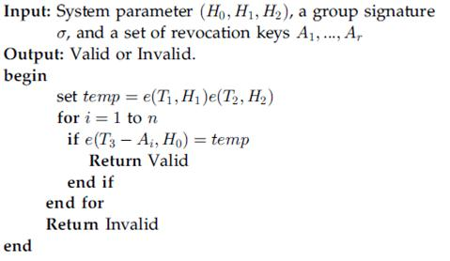
Revocation Verification

Slide 13

HARDWARE REQUIREMENTS:
System : Pentium IV 2.4 GHz.
Hard Disk : 40 GB.
Monitor : 15 inch VGA Colour.
Mouse : Logitech Mouse.
Ram : 512 MB
Keyboard : Standard Keyboard

Slide 14
SOFTWARE REQUIREMENTS:
Operating System : Windows XP.
Coding Language : ASP.NET, C#.Net.
Database : SQL Server 2005
REFERENCE:
Xuefeng Liu, Yuqing Zhang, Boyang Wang, and Jingbo Yan, “Mona: Secure Multi-Owner Data Sharing for Dynamic Groups in the Cloud”, IEEE

